Slide 1
CI/CD Process Delivery Process
Release & Deployment Management
Madhusudhana Reddy Assistant Release Manager
<November, 2019>

Slide 2
Agenda
CI/CD process with Jenkins.
Global Tools Settings.
CI/CD Process flow.
Milestone Reviews and Quality Gates- Checklist.
Q&A

Slide 3

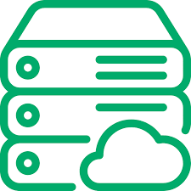

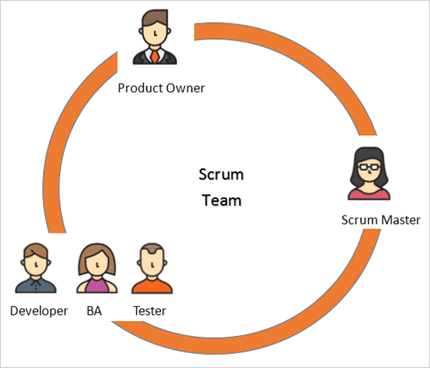
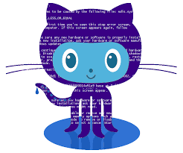

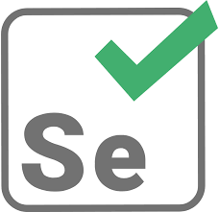
Dev Process Set up
UAT Server Results
Prod Server
Code Repository
Continuous Integration / Delivery
Company Confidential Material

Slide 4

About Jenkins
Jenkins is an open source automation server. With Jenkins, organizations can accelerate the software development process by automating it.
Jenkins manages and controls software delivery processes throughout the entire lifecycle, including build, document, test, package, stage, deployment, static code analysis and much more.
You can set up Jenkins to watch for any code changes in places like SVN and GitHub, automatically do a build with tools like Ant and Maven, utilize container technology such as Docker and Kubernetes, initiate tests and then take actions like rolling back or rolling forward in production.
Plugins installed
1. Gitlab/Bitbucket
2. Docker
3. Email Extension
4.Deployment into Azure App Service

Slide 5
Global Tool Settings.
1. Environment Variables: Key value based variables can be added here, so that we can use it in our pipelines.
2. GitLab/Bitbucket: It is a web-based DevOps lifecycle tool that provides a source code repository manager.
3. Maven:build automation tool.
4. Selenium:Selenium is a portable framework for testing web applications.
5. Docker: It is a set of platform as a service products that use OS-level virtualization to deliver software in packages called containers.
6. SMTP settings: SMTP details to send build notification.
7. System Admin e-mail address:
Set value to “xxx@xxx.xxx”, else Jenkins will try to send email with anybody@integra.co.in
8. Credentials: Need to add global credentials.

Slide 6
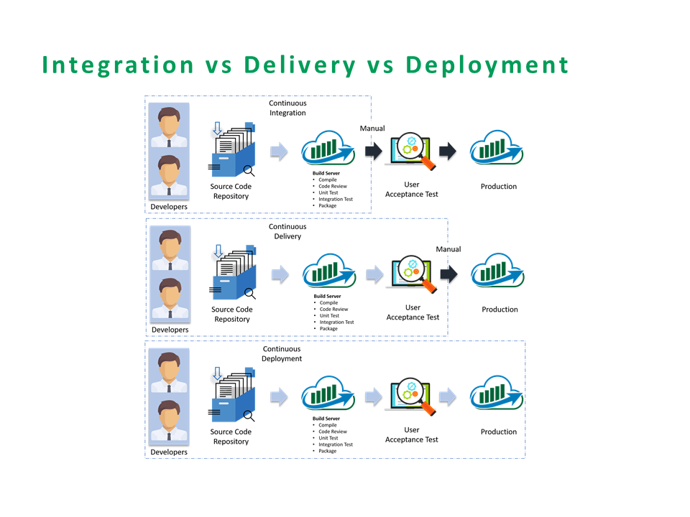

Slide 7
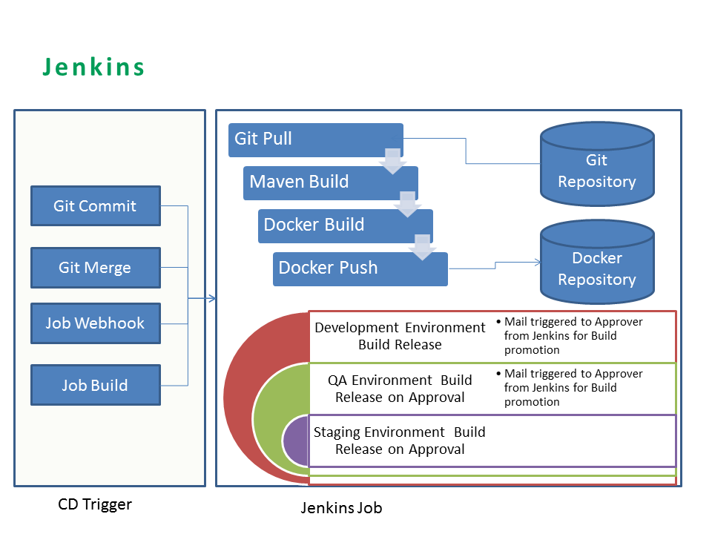
CI/CD Trigger

Slide 8
Milestone Review and Quality Gates - Checklist
30 Day Review
(before non-client RDY install)
- Dev. PM walkthrough the list of changes that are locked down for upcoming release window
15 Day Review
(before non-client RDY install)
- Review additional changes, if added with exception approval
- SD to share the plan to complete new hardware/ software/ network requirements
- Training session status
- Code Completion – 100%
- QA testing – 80% or above
- Defects
- Client Communication - Preparedness
NCR: Go/No-Go (7-Day)
Acceptance Criteria: QA Sign off including
- Technical SME’s can participate and ask questions/more information
- Dev. PM to specify any new hardware/ software/ network requirements
- Training/Knowledge sharing requirements for new feature/ functionality/ format changes
- Code complete/Peer Reviewed
- QA test cases – Peer Reviewed
- QA testing – 20% or above
PROD: Go/No-Go
CR: Go/No-Go
Acceptance Criteria:
QA
Successful Full/Complete regression testing
Successful Functional testing
Successful Performance testing (if N/A, provide reason)
Successful upgrade testing(if N/A, provide reason)
Successful install/deploy test
NO outstanding defects in final build
FINAL build – Peer reviewed for GR
Acceptance Criteria: SD
- Successful installer logs
- Zero install/deployment issue client RDY
Successful execution of all reviewed test cases for Non-client RDY from QA end.
- NO outstanding defects in non-client RDY
SD
Successful execution of all reviewed test cases in non-client RDY.
Zero install/deployment issue in non-client RDY.
Client Communication
- Crontab Jobs - Processing & Data Workflow
- Remotes
- Client Smoke Testing(*)

Slide 9

Q & A

